Slide 1

Ticker: SMR
Sector: Industrials
Industry: Nuclear Power Generation Equipment & Systems
Recommendation: BUY
Presented By:
Ronith Rajesh Reddy, Rafe Patrone, and Bansi Thakkar

Slide 2

Disclosure Statement
We have no position in any stock mentioned in this presentation and do not have plans to initiate any position within the next 72 hours.
2

Slide 3
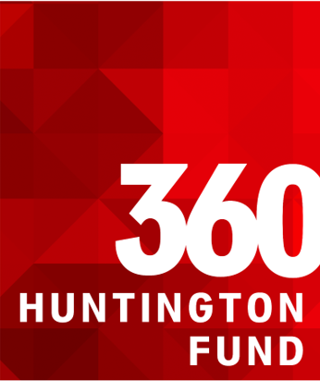
Contents
Business Overview
Market Outlook
Investment Thesis
Catalyst
SWOT Analysis
Peer Comparison
Porter's Five Force Model
Potential Risk
Stock Price Snapshot
Valuation

Slide 4
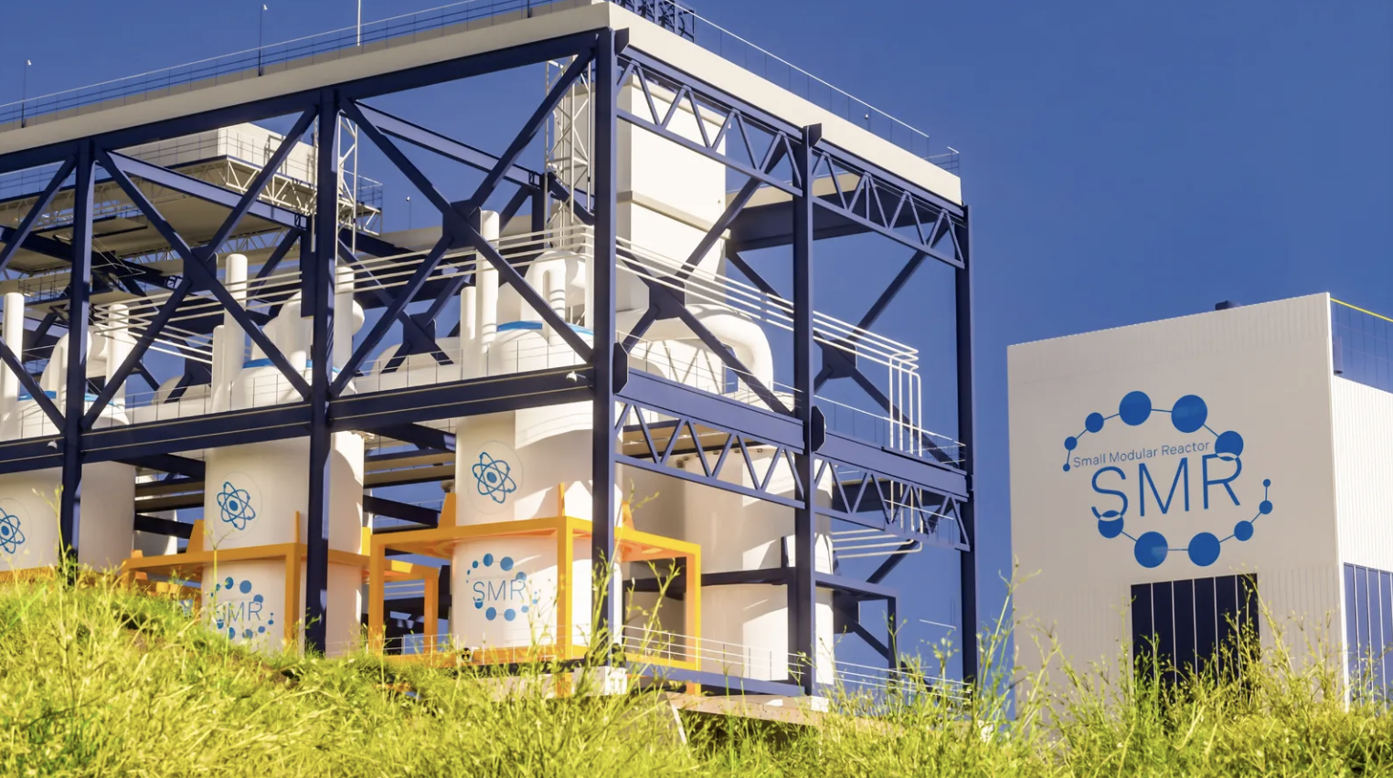
Business Overview
NuScale Power Corporation, founded in 2007, is an American energy company that designs, develops, and commercializes small modular reactor (SMR) technology for nuclear power generation.
The company's core business centers on its proprietary VOYGR SMR power plants, which feature factory-fabricated 77 MWe modules that can be deployed individually or in scalable configurations of up to 12 modules per plant.
NuScale provides comprehensive services including reactor design, licensing support, plant delivery, and operational services to utilities and power producers seeking carbon-free baseload energy solutions.
As the first company to receive U.S. Nuclear Regulatory Commission design approval for an SMR in 2020, NuScale has established itself as a pioneer in next-generation nuclear technology. Proprietary SMR technology with patented modular design and flexibility for deployment across U.S., Europe, and Asia
Revenue Mix: 100% from nuclear power generation technology and related systems
Global Presence: Developing international partnerships and deployment projects in Romania, Poland, and Canada

Slide 5
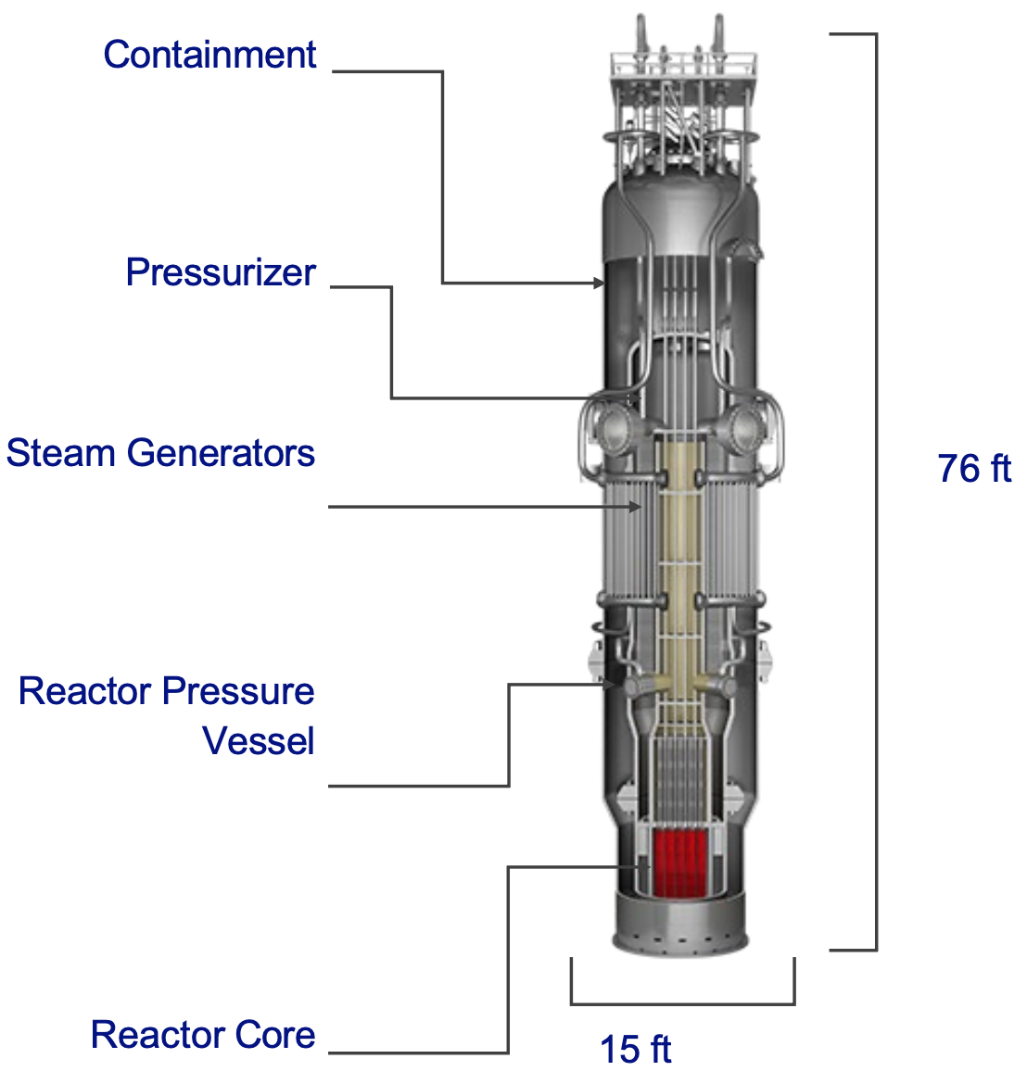
Small Modular Reactors: NuScale’s Core Innovation
Small modular reactors (SMRs) are compact nuclear power units that evolved from technology originally developed by the US military to power atomic submarines. NuScale's SMR generates 77 megawatts of clean electricity which is enough to power about 60,000 homes, in a reactor small enough to be built in a factory and transported by truck.
The company's patented design features a unique evacuated containment vessel surrounding the reactor core, creating a vacuum space that enables passive cooling and automatic shutdown without any external power, operator action, or backup systems. This means that even in worst-case scenarios, the reactor naturally shuts itself down and stays cool indefinitely using simple physics, making meltdowns extremely unlikely.
Power plants can deploy multiple modules as needed, allowing utilities to start small and scale up over time rather than committing billions upfront to a traditional large reactor.
Power (MW) | Source | Land Needed
300 | 4 SMR | 15 – 25 acres
300 | 750,000 400W Solar Panels | 1,500 – 2,000 acres
300 | 25-125 Wind Turbines | 5,000 – 10,000 acres
300 | 37,200 Gallons of Oil | 30 – 50 acres

Slide 6

Strategic Portfolio Fortification
Current Position:
Our exposure to the nuclear sector is currently very limited, leaving the fund underrepresented in a key area of the global clean energy transition.
Strategic Rationale:
This investment diversifies our energy holdings beyond conventional renewables and fossil fuel-adjacent assets while capturing exposure to government-supported baseload power with proven scalability.
Nuclear's high regulatory and capital barriers create a defensible competitive moat, offering the fund early entry into a sector positioned for decades of structural growth as data centers, industrial electrification, and grid reliability demands accelerate.
The combination of policy tailwinds, technological maturity, and limited competition presents an asymmetric risk-reward opportunity aligned with our long-term investment horizon.

Slide 7
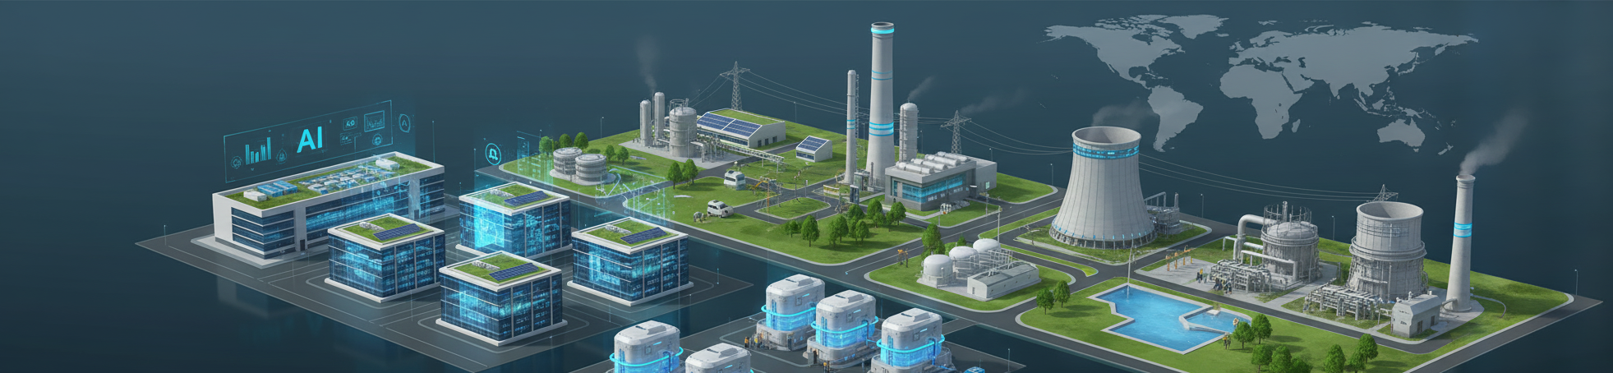
Industry Overview
The global SMR market is projected to exceed $120 billion by 2035, growing at 15%+ CAGR as industries race to secure reliable zero-carbon power. With over 16,000 GW of baseload demand emerging globally, nuclear stands alone in its ability to deliver continuous clean energy at scale.
Key Growth Drivers:
Data Centers & AI: Hyperscalers need 24/7 carbon-free power to meet sustainability commitments while supporting explosive growth in AI workloads—SMRs offer the only scalable solution beyond constrained renewable grids.
Coal Plant Replacement: Over 80% of retiring U.S. coal sites can be converted to SMR facilities, leveraging existing grid connections and workforce to cut construction costs by 15-35%.
Industrial Decarbonization: Beyond electricity, SMRs enable hard-to-abate sectors to decarbonize through high-temperature process heat, hydrogen production (200+ tons daily), and desalination (150 million gallons per day per module).
Competitive Advantage: NuScale holds the only NRC-approved SMR design globally, with commercial partnerships spanning 12 countries and a project pipeline exceeding 20 GW. This 5-7 year regulatory lead over competitors creates a massive first-mover advantage in capturing early market share.

Slide 8
SMR’s Position in Market
Domestic Operations
Financial Performance: Q2 2025 revenue reached $56.1 million, representing 700% year-over-year growth. Market capitalization of $13.04 billion positions NuScale among the top 1,000 companies globally by valuation.
International Operations
Strategic Partnerships: Secured government-backed agreements in key markets including Romania (462 MWe Doicești project), Poland (industrial applications), and Canada (grid-scale deployment), with commercial operations targeted for early 2030s.
Innovation and Technology Leadership
Strategic Positioning: Designated as critical infrastructure for U.S. energy independence and a cornerstone technology for American nuclear exports, competing directly with Russian and Chinese state-backed SMR programs.
Core Product: Single flagship offering—the VOYGR™ SMR platform, delivering 77-924 MWe of scalable clean baseload power through modular deployment.
Infrastructure: Advanced engineering and testing facilities in Corvallis, Oregon (headquarters and R&D center) and Richland, Tennessee (fabrication and testing), supporting design validation and commercial deployment.
Revenue Profile: International contracts currently in early development phase, representing multi-billion dollar future revenue pipeline as projects advance from planning to construction.
Funding and Partnerships: Backed by $600+ million in Department of Energy grants, strategic investment from Fluor Corporation (majority shareholder), and commercial partnerships with Nuclearelectrica and major utilities spanning 12 countries.

Slide 9
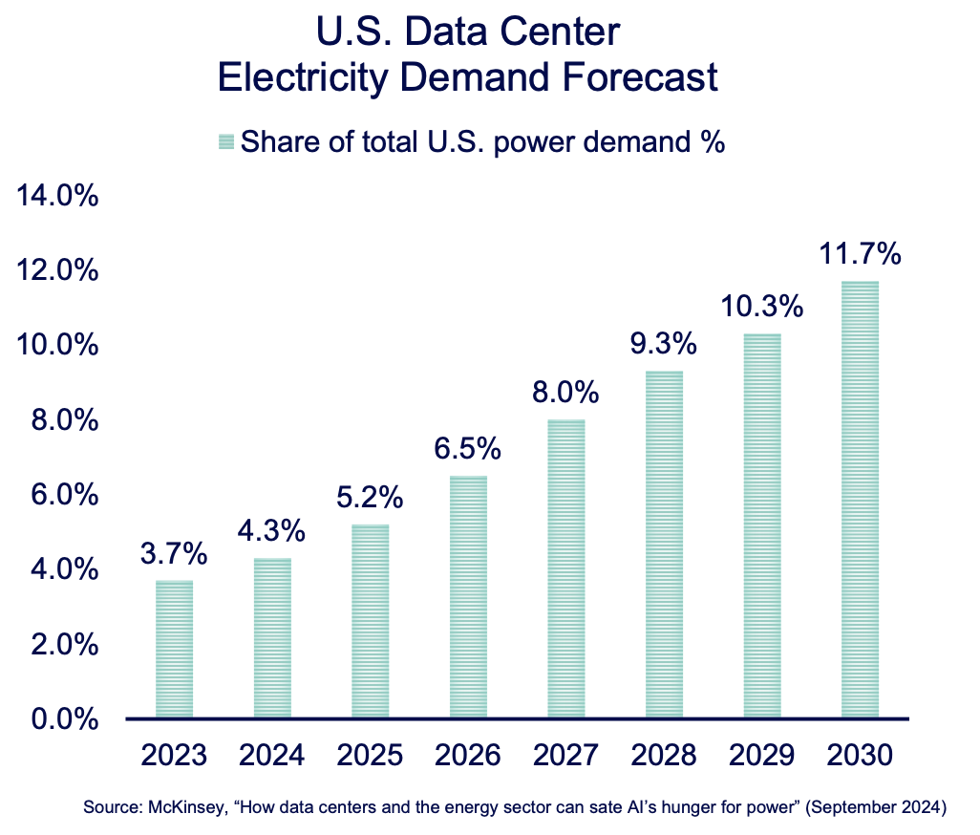
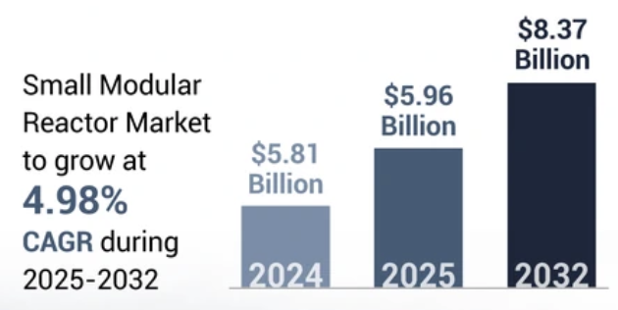
Investment Thesis
AI & Data Center Power Surge
Explosive AI workloads are creating unprecedented, non-cyclical demand for electricity.
U.S. data center consumption expected to rise from 4% to ~10% of national power use by 2030.
Hyperscalers (Microsoft, Google, Amazon) are securing long-term nuclear PPAs to guarantee carbon-free, 24/7 supply.
SMRs represent the only scalable, zero-carbon baseload solution capable of meeting this new digital-era demand.
Decarbonization & Net-Zero Imperatives
Achieving global net-zero targets will require tripling current nuclear capacity by 2050 (IEA).
Intermittent renewables face grid stability limits beyond ~40% penetration.
SMRs provide firm, dispatchable clean power, bridging the reliability gap between renewables and fossil fuels.
Carbon pricing and renewable mandates effectively subsidize nuclear competitiveness.
Energy Security & Grid Resilience
Ongoing geopolitical conflicts underscore energy independence as a strategic priority.
SMRs enable distributed generation, reducing transmission risk and grid vulnerability.
Applications across defense bases and remote infrastructure create high-value premium demand for modular nuclear systems.

Slide 10
Investment Thesis
Industrial Onshoring & Electrification
Semiconductor fabs, hydrogen production, and heavy manufacturing require continuous, low-cost power.
Policy & Financial Tailwinds
The ADVANCE Act (2024) reduced NRC approval timelines by up to 40%.
Technology Maturation & Cost Competitiveness
NuScale, X-energy, TerraPower are advancing from design into active construction phases.
Capital Efficiency & Market Accessibility
U.S. policy incentives (CHIPS Act, IRA) are catalyzing domestic industrial buildouts.
SMRs offer co-location advantages and access to industrial heat for steel, cement, and chemical processes.
DOE loan guarantees and 45U tax credits ($15/MWh) strengthen project economics.
Broad bipartisan support ensures long-term policy stability for nuclear investment
Factory fabrication enables scalable production and cost deflation through learning curves.
Expected LCOE of $60–90/MWh makes SMRs cost-competitive with gas — minus the fuel volatility.
$1–3B modular projects vs. $10–20B conventional nuclear enable more flexible financing.
3–5 year construction cycles shorten payback periods and reduce financing exposure.
Modular scale expands access for utilities, governments, and private investors alike.

Slide 11
Catalysts

Slide 12

Regulatory & Technical Milestones
Unmatched Regulatory Position: NuScale remains the only NRC-certified SMR design globally—competitors are years behind, creating insurmountable first-mover advantage in securing early commercial contracts
77 MWe Power Uprate (Mid-2025): NRC approval progressing on schedule to increase output by 54% per module, fundamentally improving project economics and customer ROI
Construction Transition: First commercial plant site preparation complete with concrete pour expected in 2026, marking the industry's shift from development to physical deployment
Revenue Inflection Underway: Early-stage revenues from RoPower Romania engineering work accelerating, with increasing visibility as FEED Phase 2 advances toward construction contracts
Combined License (COL) Pipeline: Multiple site-specific licenses in final review, each approval immediately unlocks construction start and billions in project value
Commercial Operation (2029-2030): These milestones collectively de-risk the technology and validate NuScale's near-term deployment readiness, with first units demonstrating real-world performance to catalyze fleet orders
Each milestone achieved strengthens NuScale's competitive moat and accelerates the path to scaled commercial deployment

Slide 13
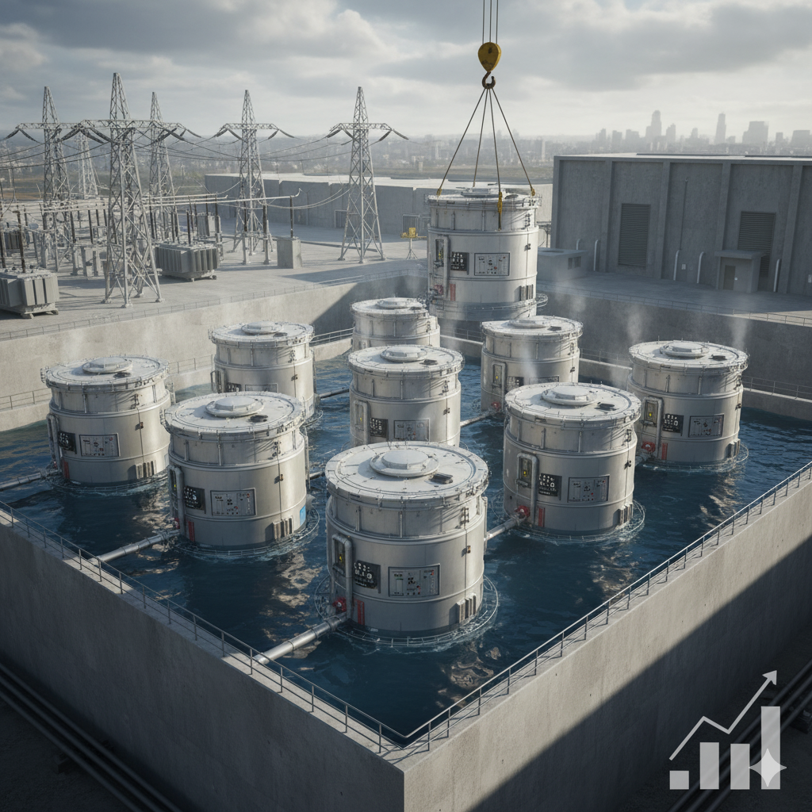
Commercial Traction & Revenue Visibility
Commercial Breakthrough Imminent First firm customer order anticipated by late 2025, validating market demand. Romania's 462 MWe RoPower project—the world's first commercial SMR deployment—advances toward final investment decision in Q1-Q2 2026, with six VOYGR modules ready for construction.
Accelerating Market Traction Active negotiations spanning utilities, hyperscale data centers, and industrial customers, with multiple coal-to-nuclear conversion opportunities in advanced discussions. Strategic equity investments from tech giants (Microsoft, Google, Amazon) signal private sector confidence in SMR economics.
Supply Chain & Manufacturing Ready Key partnerships operationalized with URPV (reactor modules), Framatome (nuclear fuel), Honeywell and Paragon (control systems)—enabling scaled production as orders materialize.
Revenue Momentum Building Q1 2025 revenue surged to $13M from
$0.5M prior quarter, reflecting engineering contract acceleration. Broad power purchase agreement (PPA) interest from diverse sectors indicates robust demand pipeline converting to contracted backlog.

Slide 14
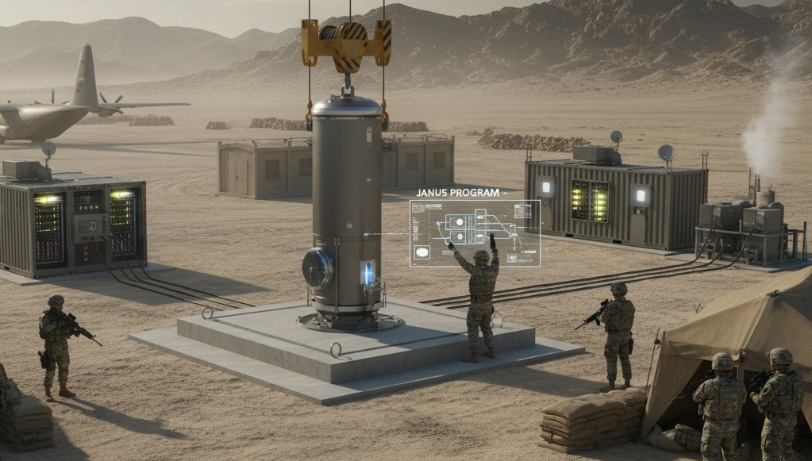
Government Support & Funding Acceleration
Military Contracts: Army's Janus Program requires operational reactors by 2028—NuScale's NRC certification positions it as prime defense contractor
Tax Credits Transform Economics: IRA's 30-40% ITC plus production credits create 50%+ effective subsidy, dramatically improving project IRRs
DOE Capital Access: $50B+ in loan guarantees available, $900M+ grants secured—multi-billion dollar non-dilutive financing ready for construction phase
State-Level Fast-Tracking: Multiple states accelerating SMR licensing and converting coal sites—80% of retiring coal plants viable for nuclear with existing grid infrastructure
Export Finance: EXIM Bank and State Department backing international deployments—opening $100B+ global market opportunity
Bipartisan Lock-In: ADVANCE Act ensures funding continuity across administrations—nuclear support transcends political cycles
Federal commitment has shifted from policy support to active deployment acceleration

Slide 15
SWOT Analysis
Strengths | Weaknesses | Opportunities | Threats
NuScale is the first U.S. company to receive NRC (Nuclear Regulatory Commission) design approval for its small modular reactor, giving it a significant regulatory and credibility edge over competitors. | Despite strong technology, NuScale has yet to fully commercialize or deploy an operating SMR plant, resulting in negative cash flow and high burn rate. | Rising global demand for carbon-free, baseload power positions NuScale as a key player in the next generation of nuclear energy. | Rapid cost declines in solar, wind, and batteries—and competition from GE Hitachi, Rolls-Royce SMR, and others—could limit NuScale’s market share.
Its modular design uses passive safety systems (no operator or external power needed for shutdown), addressing key public and regulatory concerns about nuclear safety. | Manufacturing and site development are extremely expensive, making the company dependent on government funding, partnerships, and equity raises. | Increasing U.S. and international funding for nuclear innovation (especially under DOE and IRA initiatives) could accelerate project deployment. | Failure to secure long-term contracts or financing could delay commercialization and dilute shareholders through further capital raises.
NuScale’s reactors can be deployed in 77 MW modules, allowing utilities and industrial customers to scale generation to match demand—reducing capital risk. | As a small-cap, pre-revenue company, SMR’s stock is highly volatile and sensitive to market sentiment, policy headlines, and speculative investor behavior. No operational track record yet to prove real-world reliability or cost efficiency compared to projections | NuScale’s smaller, transportable design makes it attractive for developing nations, remote regions, and military or industrial applications. | Any unforeseen technical flaws, construction delays, or overruns in early deployments could significantly damage credibility and valuation.

Slide 16
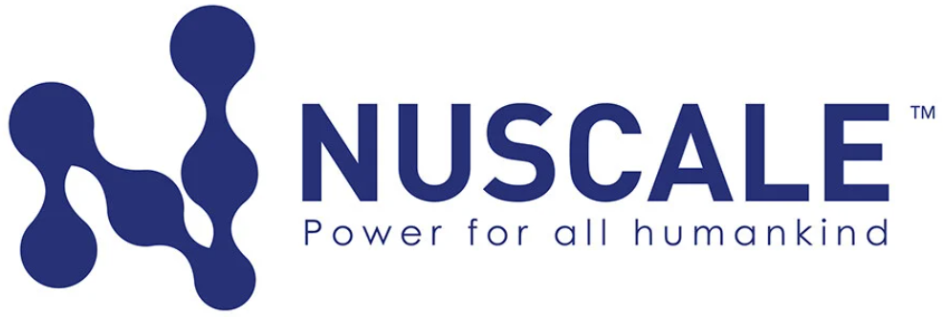

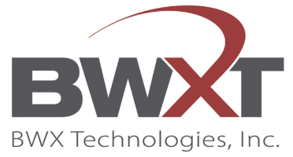
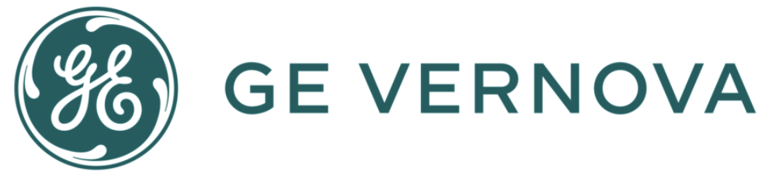
Peer Comparison
Particulars
Market Capitalization | $13.04B | $24.21B | $18.5B | $163.51B
Revenue (TTM) | $56,128 | $0 | $2,864,520 | $36,615,000
FCF (TTM) | $-95,363 | $-38,742 | $360,283 | $2,708,000
Annual EPS (FY2024) (TTM) | -0.55 | -0.38 | 3.49 | 6.30
Products & Services | Electrical Power Equipment ~ SMR (100%) the design, manufacturing, and deployment of advanced nuclear reactor technology for clean energy generation. | Nuclear Power Generation (N/A) | Nuclear Power Generation Equipment (84.1%) Other Machinery and Equipment (15.9%) | Wind Energy Equipment and other Renewable Energy Equipment (21.77%) Operations & Maintenance (4.73%) Energy Facilities (35.55%) Turbine Generators (16.34%) Electrical Power Grid Parts and Services (21.61%)
Geographic Reach | United States, Asia, Europe | United States | United States | United States, Europe, Asia, Middle East, Africa, Americas

Slide 17


Porter’s Five Forces Analysis
Threat of New Entries | Bargaining Power of Supplier | Bargaining Power of Buyer | Threat of Substitution | Competitor Analysis
Low to Moderate | High | Moderate to High | Moderate to high | High
Regulatory Barriers: NRC design certification is extremely costly and time-consuming, creating a high entry barrier. | Limited Suppliers: Few qualified producers exist for nuclear-grade materials, components, and HALEU fuel. | Concentrated Customer Base: Buyers are large utilities or governments that negotiate billion-dollar contracts. | Renewables & Storage: Solar and wind paired with batteries are becoming cheaper and faster to deploy. | Strong Competition: GE, Rolls-Royce, X-Energy, and TerraPower all target the same SMR market.
Capital Intensity: Building nuclear technology requires billions in R&D, manufacturing, and safety compliance. | Strict Regulations: Suppliers must meet nuclear safety and compliance standards, reducing available options. | Alternative Options: Renewables, gas, or other SMRs give buyers leverage in pricing and terms. | Natural Gas: Provides flexible, reliable baseload power at lower upfront costs. | Execution Risk: NuScale’s canceled UAMPS project shows how cost and timing issues can erode trust.
Technical Expertise: Specialized engineering and safety standards limit how many firms can realistically compete. | Cost Sensitivity: Supply disruptions or cost increases can cause major project delays and budget overruns. | Risk Aversion: Long project timelines and uncertain returns make customers demand strict guarantees. | Other SMRs: Competitors like GE-Hitachi and Rolls-Royce offer similar nuclear solutions with strong backing. | Race for Market Share: Success will depend on who commercializes first, delivers the lowest cost per MW, and secures contracts.
13

Slide 18
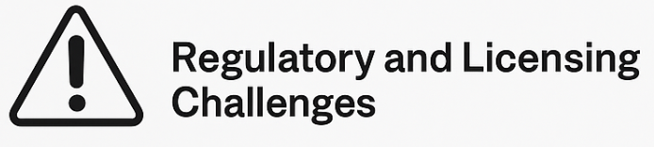
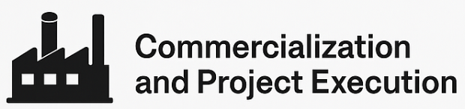
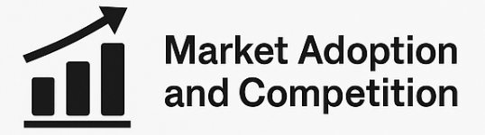

Potential Risks
NuScale’s operations depend heavily on timely approval from the U.S. Nuclear Regulatory Commission (NRC) and international regulators. Delays or changes in safety standards could increase development costs or postpone project deployment.
As an emerging technology company, NuScale faces uncertainty in scaling up production and executing first-of-a-kind projects. Cost overruns, supply chain issues, or partner withdrawals could affect profitability and credibility.
Widespread adoption of SMRs is not yet proven. Utilities and governments may favor traditional large-scale reactors or renewable energy alternatives, limiting near-term demand for NuScale’s technology.
Changes in political priorities, public attitudes toward nuclear energy, or increased focus on renewables could reduce policy support or delay customer commitments.

Slide 19
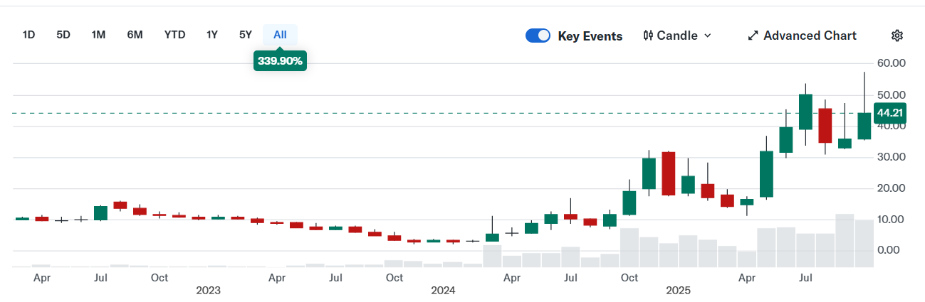
Stock Price Snapshot

Slide 20
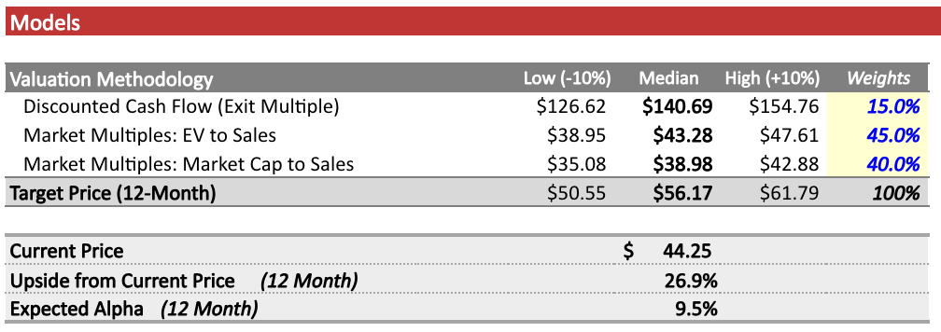
Valuation

Slide 21
Questions?

